Slide 1

Unit 1:- Electric and Hybrid Powertrain Technologies
By:- Dr. Chetan Khadse

Slide 2
Syllabus…Unit 1 Focus On….
Lecture | Topics to be covered
L1 | Introduction to vehicles, IC engine & Battery Electric Vehicles (BEV’s) , history and social importance
L2 | Benefits of E vehicles, Types of E-vehicles on the basis of propulsion devices, Energy sources and energy carriers.
L3 | PEV’s & HEV’s , BEV, HEV, FCEV, UCEV and UFEV
L4 | Classification of HEV, Micro hybrid, mild hybrid, full hybrid, plug-in hybrid and range extended hybrid electric vehicle.
L5 | Parallel hybrid, Series Hybrid, Power split and compound Hybrid Configuration Plug-in Hybrid Electric Vehicles (PHEV’s),
L6 | Hybrid Hydraulic vehicles (HHV),Pneumatic Hybrid Vehicles, (PHVs)
L7 | Power/Energy Management System

Slide 3
Lecture 4
BEV (Battery Electric Vehicle)
BEV Internal Blocks
Fuel Cell Electric Vehicle
Integrated Starter Generator (ISG)
Micro, Mild and Full Hybrid
Micro Hybrid Schematic
Micro Hybrid
Mild Hybrid Schematic
Mild Hybrid
Micro, Mild and Full Comparison
OOL in Full Hybrid
Grid-able HEV
Types of Full Hybrid

Slide 4
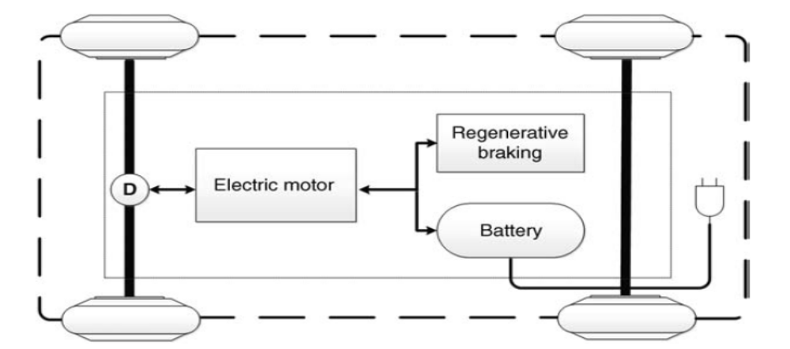
BEV (Battery Electric Vehicle)….
The figure depicts a schematic of a battery-powered electric vehicle (BEV).

Slide 5
BEV (Battery Electric Vehicle)….
BEVs use one or more electric motors for propulsion and batteries to store electricity.
The battery bank in a BEV is normally charged directly from the grid using a battery charger
The electrical energy stored in the battery is transferred to the wheels using an electric drive consisting of a power converter and electrical machine via transmission gears and differential.
This power converter has to be designed to carry bidirectional power flow since it can also be used to regenerate the power coming from the wheels during braking.
Clutch is normally not required in a battery electric vehicle as in conventional IC engine based vehicle.

Slide 6
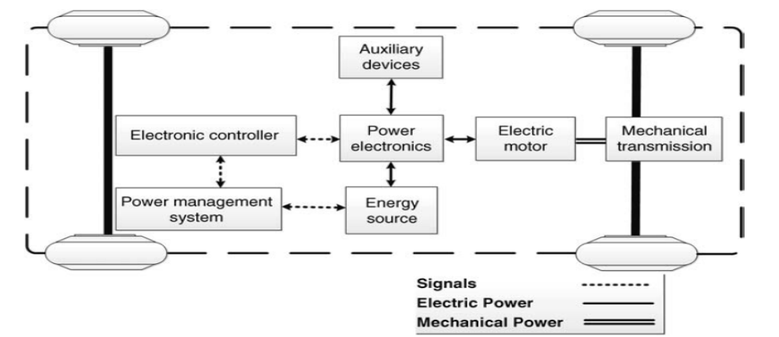
BEV Internal Blocks….
Due to the limited capacity of EV battery packs, the driving range currently possible on a single battery charge is shorter than that of a conventional vehicle running on a full tank of gasoline.

Slide 7
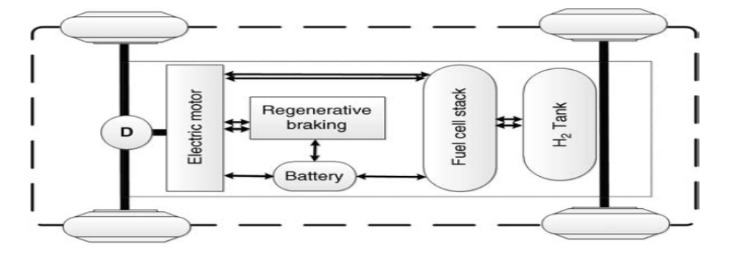
Fuel Cell Electric Vehicle….
It uses fuel cell as a source of energy which is connected to hydrogen tank.
A boost converter is required to step up the voltage of the fuel cell to charge the battery and store the energy.
Battery bank enables two purposes. First, it allows fuel cell to operate at optimum efficiency. Secondly, it can support the transient mechanical energy requirements at the wheels.

Slide 8
Fuel Cell Electric Vehicle….
It can also help to store the regenerative energy coming during braking since fuel cell is incapable of storing the regenerative energy.
The most prominent advantage of FCEVs is their driving range, which is similar to that of a vehicle operating with an ICE.
What determines the FCEV range is the amount of hydrogen fuel available in the fuel tank, independent of the fuel-cell size.
In fact, the relevance of fuel-cell sizes is contingent on the required power level of the FCEVs.
A fuel-cell is not a storage device. It is an energy source unit where generated electricity either provides direct power to the traction motors or remains stored in the on-board energy storage for future use.

Slide 9
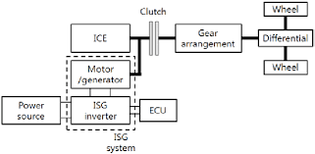
Integrated Starter Generator ….

Slide 10
Integrated Starter Generator (ISG)….
IC engine requires a starter motor for starting IC engine and an alternator to recharge the battery once the IC engine has started functioning.
These two functions can be clubbed together in a device called integrated starter generator or ISG in short form.
An ISG in an electrical machine which can be connected to the IC engine either using a belt driven system or it can be directly mounted to the crankshaft.
It can assist IC engine in various ways
  Start /Stop & Instant Restart
  Regenerative Braking
  Torque Augmentation
    Boost / Launch

Slide 11
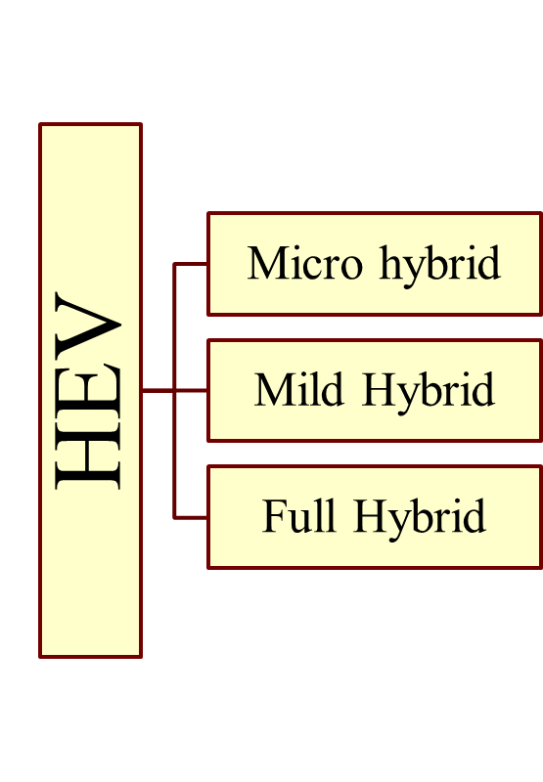
Micro, Mild and Full Hybrid ….
Micro hybrid:
  ISG, 3 to 5 KW, 14 to 42 volts
  Start/stop, Regenerative Braking.
  Mild hybrid
  ISG, 7 to 15 KW, 100 to 150 volts
  Start/stop, Regenerative Braking
  Power Assist
  Full hybrid
  Electronic Variable Transmission,
  50 to 60 KW, 500 to 600 volts
  Start/stop, Regenerative Braking
  Power Assist, Electric Launch
  High efficiency mode in Optimal Operation Line (OOL) mode in ICE

Slide 12
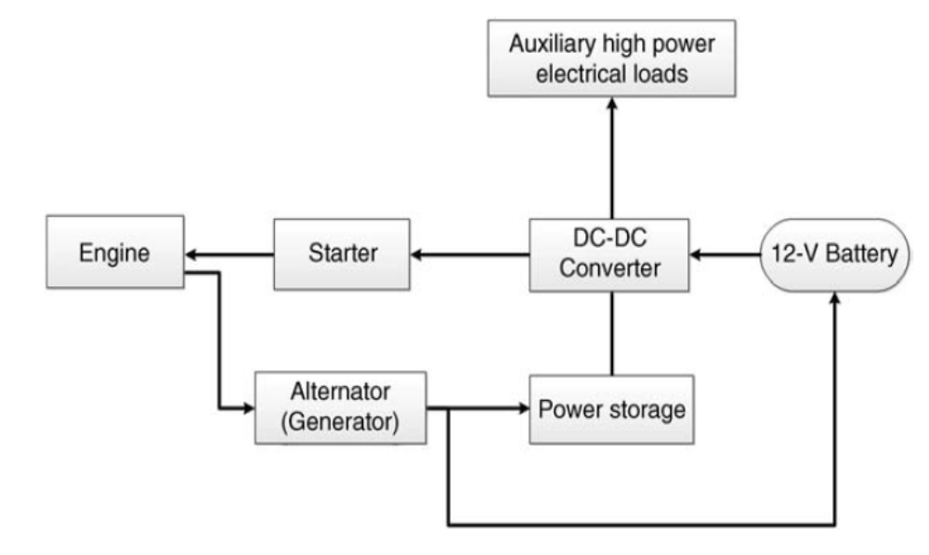
Micro Hybrid Schematic ….

Slide 13
Micro Hybrid ….
A micro-hybrid is a vehicle in which an electric machine functions in applications such as stop/start and regenerative braking, but not to supply additional torque when the engine is running.
Most micro-hybrid applications have been focused on small gasoline engines, but the achievement of stop/start in a diesel engine is a considerably greater challenge due to the much higher starting torque requirement.
The BMW 1 series and the Smart For two, manufactured by Mercedes, are examples of commercialized micro-hybrid vehicles

Slide 14
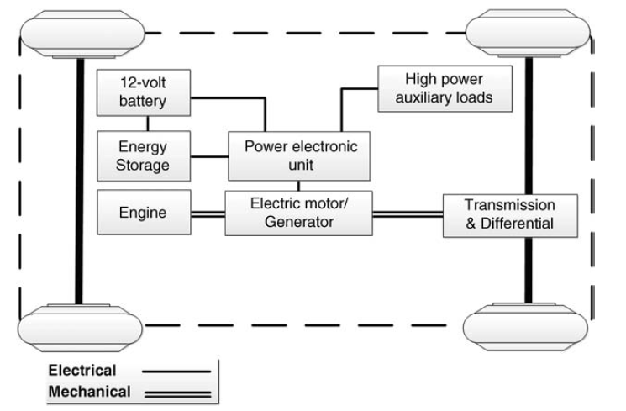
Mild Hybrid Schematic ….

Slide 15
Mild Hybrid ….
A mild-hybrid has an electric motor-generator integrated to provide up to approximately 10% of the maximum engine power in the form of additional torque.
Mild HEVs improve the drawbacks of fossil-fuel vehicles, where engine efficiency is not at its maximum levels.
The ICE consumes more fuel and emits more emissions when coasting, braking, or idling. Mild HEVs can provide some level of power assistance to the engine whenever the engine is not efficient, and are able to provide engine start–stop functionality.
Moreover, during idling, they can turn off the engine and use electric power instead.

Slide 16
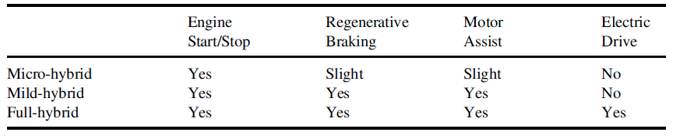
Micro, Mild and Full Comparison….

Slide 17
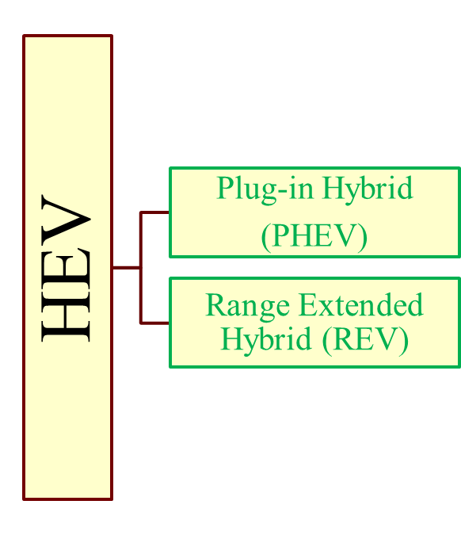
Grid-able HEV….
  Plug in Hybrid
    Derived from Full Hybrid.
    Mostly operates in the blended mode. The electric motor and IC engine complements each other, in such a way that the fuel economy is maximum
    Requires a higher battery bank compared to a full hybrid
  Range Extended Vehicle
  Derived from a battery electric vehicle. Operates in pure electric mode
Works till a threshold of battery pack voltage is reached where it starts the smaller rated IC engine to charge the battery.

Slide 18
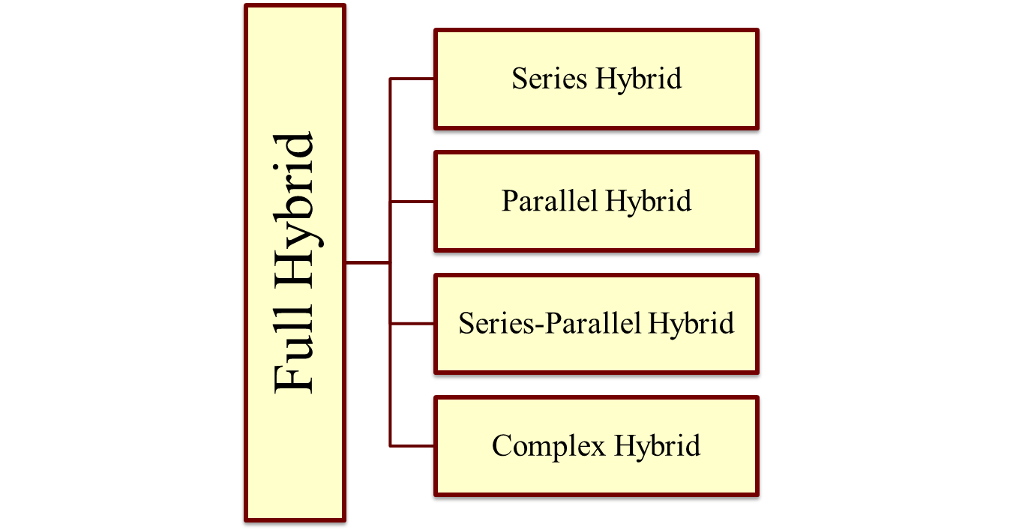
Types of Full Hybrid ….
A full hybrid HEVs can be further classified into four types. Will study it in details latter.

